Slide 1

Lecturer :
Bambang P, S.Pd.,MM

Slide 2

Students have to attend 80% from the whole lesson.
Students have to be punctual/on time in attending the lesson. No class for 15 minutes late.
Students must send a letter in advance if she/he cannot attend the lesson more than 5 times in order. Breaking this point means no exception given.

Slide 3

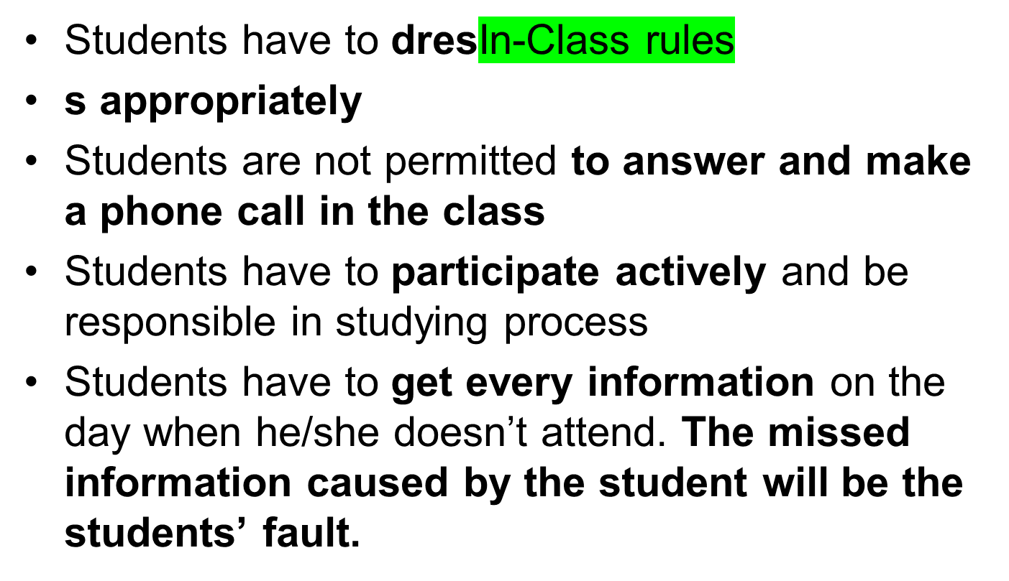

Slide 4

Students will be scored from daily performance (attendance, attitudes, and participation)
Students will be scored from every assignment given
Students will be scored from the essay she/he makes. Any plagiarism is not tolerated.

Slide 5

Those points are students requirements to pass this study.

